Slide 1
Implementing the Convention at the international level
RAT PPT 2.5
UNESCO
Intangible Cultural Heritage Section

Slide 2
In this presentation…
The two Lists of the Convention
The Register of best practices
International assistance and cooperation

Slide 3
The Lists of the Convention
Urgent Safeguarding List
Endangered ICH
Promotes safeguarding and provides assistance, incl. financial assistance
Recognizes value of endangered ICH for communities
Currently 16 elements
Representative List
Viable ICH
Raises visibility and awareness, while promoting cultural diversity and creativity
Encourages dialogue and understanding
Currently 213 elements

Slide 4
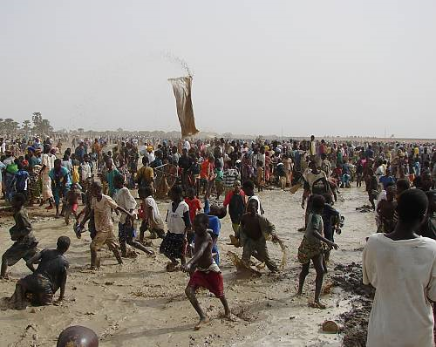
The Sanké mon: collective fishing rite of the Sanké
The Sanké mon collective fishing rite takes place annually in the Ségou region of Mali to mark the beginning of the rainy season and commemorate the founding of the town San.
In recent years, fewer people attend the rite, because of decreasing awareness of its function and history, occasional accidents and the degradation of the Sanké Lake
© Direction nationale du patrimoine culturel, Ministère de la culture du Mali

Slide 5
The Tango
The Tango, its music, dance and songs, is a symbol of the popular culture of Argentina and Uruguay, especially their capital cities. Originating in working class neighbourhoods of Buenos Aires, the Tango dates back to the late nineteenth century. Practiced spontaneously or in more formal settings, it enjoys great popularity locally and worldwide.

Slide 6
Evaluation criteria
6 criteria for USL nominations (OD 1)
5 criteria for RL nominations (OD 2)
Criteria for the two lists are very similar, with one exception

Slide 7
Nominations to the Lists of the Convention:
Urgent Safeguarding List
States Parties nominate elements, with community participation
Nomination Form ICH 01
Examination by Consultative Body
Reporting cycle = 4 years
Preparatory assistance
Representative List
States Parties nominate elements, with community participation
Nomination Form ICH 02
Examination by Subsidiary Body
Reporting cycle = 6 years
No preparatory assistance

Slide 8
Register of Good Practices (Article 18)
.
Safeguarding and other programmes, projects and activities that best reflect the principles and objectives of the Convention
For sharing best experiences in implementing the Convention or safeguarding ICH
In 2009: first 3 practices inscribed.

Slide 9
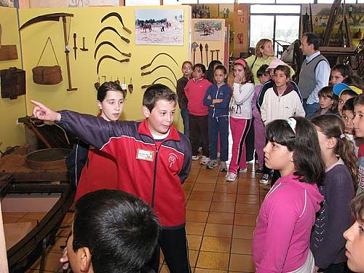
School museum of Pusol (Spain)
Guided by teachers, children explore the rich heritage of Elche by working with tradition-bearers and documenting their heritage.

Slide 10
The Register of the Convention: nominations
Register (Article 18)
States Parties nominate elements
Nomination Form ICH 03
Examination by Consultative Body
Preparatory assistance available

Slide 11
Timetable: nominations to Lists and Register
31 March: Nominations submitted
June to Sept: Nominations assessed by Secretariat and completed by States Parties
Dec-May: Nomination files examined by Consultative Body or Subsidiary Body
Sept-Nov: Nomination files evaluated by Committee
YEAR 1
YEAR 2
Referral of incomplete RL nominations
Inscription and selection decisions

Slide 12
International cooperation
Multinational nominations of shared heritage
Exchange of information and expertise
Joint initiatives and projects
Participation in the organs of the Convention
Participation in specialized Category II centres

Slide 13
Multinational nominations
Much ICH is shared across borders
Collaboration aids safeguarding of shared heritage and furthers mutual understanding
The Convention encourages multinational nominations and joint safeguarding projects

Slide 14
International assistance
The ICH Fund
Contributions of States Parties
Voluntary supplementary contributions
International fund-raising campaigns

Slide 15
Aims of International Assistance
Safeguarding of elements on the Urgent Safeguarding List
Preparation of inventories
ICH safeguarding projects
Other activities including preparatory assistance and capacity building

Slide 16
Making an application: forms
Projects for safeguarding ICH
under US$ 25,000
over US$ 25,000
emergency assistance
USL preparatory assistance
Article 18 preparatory assistance
Form ICH 04
Form ICH 05
Form ICH-06

Slide 17
Evaluation of international assistance requests
31 March (Year 1):
IA requests over 25,000 USD
Preparatory assistance
Any time:
Emergency IA requests
IA requests under 25,000 USD
Requests under 25,000 USD and any emergency and preparatory assistance requests
evaluated by Bureau
Requests over 25,000 USD examined by Consultative Body
Decision by Committee in November (Year 2)
Decision by Bureau as soon as possible

Slide 18
Evaluation criteria include
Community participation
Well conceived and feasible
Lasting effects
Lead to capacity building.
Beneficiary State Party shares the cost as far as possible

Slide 19
Priority may be given to:
Developing states
Cross-border heritage
International cooperation
Projects with multiplier effects
Equitable geographical distribution of projects is a consideration

